Slide 1
Recursion in C

Slide 2


Slide 3
Definition (Mathematical)
process of defining something in terms of itself, and is sometimes called circular definition.
objects are defined in terms of other objects of the same type.
The entire class of objects can then be built up from a few initial values and a small number of rules.

Slide 4
Definition (Computer Science)
A recursive function is one which calls itself.
useful in evaluating certain types of mathematical function
When a function calls another function and that second function calls the third function

Slide 5
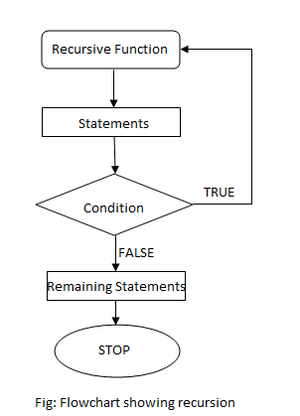
Syntax of Recursion
returntype recursive_func ([argument list])
{
statements;
... ... ...
recursive_func ([actual argument]);
... ... ...
}

Slide 6
Problems Suitable for Recursive Functions
One or more simple cases of the problem have a straightforward solution.
The other cases can be redefined in terms of problems that are
closer to the simple cases.
The problem can be reduced entirely to simple cases by calling the recursive function.
If this is a simple case solve it else redefine the problem using recursion

Slide 7
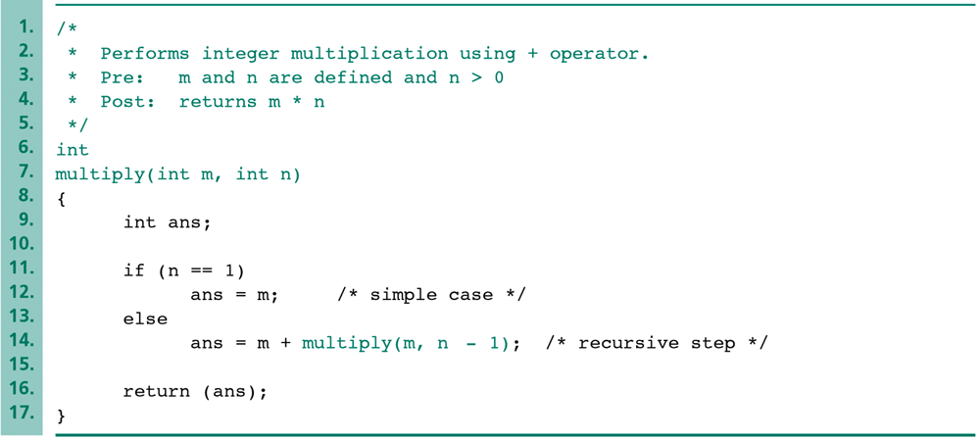
Example: multiplication by addition
The simple case is “m*1=m.”
The recursive step uses the following equation: “m*n = m+m*(n-1).”

Slide 8
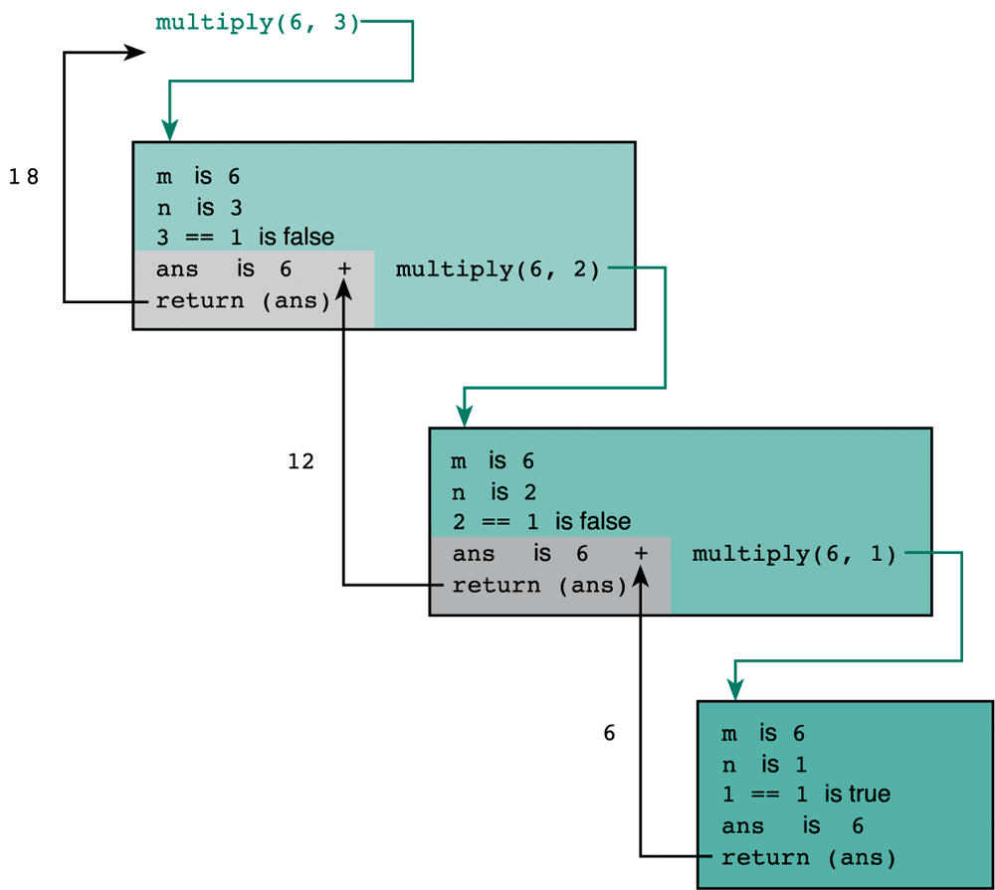
Trace of Function multiply(6,3)
The recursive step.
The recursive step.
The simple case.

Slide 9
Terminating Condition
The recursive functions always contains one or more terminating conditions.
A condition when a recursive function is processing a simple case instead of processing recursion.
Without the terminating condition, the recursive function may run forever.
e.g., in the previous multiply function, the if statement “if (n == 1) …” is the terminating condition.

Slide 10
Types of Recursion
Direct Recursion
A function is said to be direct recursive if it calls itself directly.
int fibo (int n)
{
if (n==1 || n==2)
return 1;
else
return (fibo(n-1)+fibo(n-2));
}
Indirect Recursion
A function is said to be indirect recursive if it calls another function and this new function calls the first calling function again.
int func1(int n)
{ if (n<=1)
return 1;
else
return func2(n);
}
int func2(int n)
{
return func1(n);
}

Slide 11
Simple example
main() { printf(“This is an example of recursive function”); main(); }
When this program is executed, the line is printed repeatedly and indefinitely.
We might have to abruptly terminate the execution.

Slide 12
Factorial Calculation
long int fact(int n) /* non-recursive */ { int t, ans; ans = 1; for(t=1; t<=n; t++) ans = ans*t; return(ans); }
long int factr(int n) /* recursive */ { int ans; if(n==1) return(1); ans = factr(n-1)*n; /* recursive call */ return(ans); }

Slide 13
Implementation of Factorial recursion using Stack

Slide 14
Recursive version of power function
double power(double val, unsigned pow)
{
if(pow == 0) /*pow(x, 0) returns 1*/
return(1.0);
else
return(power(val, pow-1)*val);
}

Slide 15
How recursive functions works???
When a function calls itself, a new set of local variables and parameters are allocated storage on the stack, and the function code is executed from the top with these new variables.
A recursive call does not make a new copy of the function. Only the arguments are new.
As each recursive call returns, the old local variables and parameters are removed from the stack and execution resumes at the point of the function call inside the function.

Slide 16
Summing up the elements of an array
Algorithm Design:
1. If we have only one element, then the sum is simple.
2. Otherwise, we use the sum of the first element and the sum
of the rest.
int sum(int first,int last,int array[])
{ if (first == last)
return (array[first]);
return(array[first]+sum(first+1,last,array));
}

Slide 17
For example:
Sum(1 8 3 2) = 1 + Sum(8 3 2) =
8 + Sum(3 2) =
3 + Sum (2)=
2
3 + 2 = 5
8 + 5 = 13
1 + 13 = 14
Answer = 14

Slide 18
Recursive Version of Fibonacci Series
int fib(int num) /*Fibonacci value of a number */
{
switch(num)
{ case 0: return(0);
break;
case 1: return(1);
break;
default: /*Including recursive calls */
return(fib(num - 1) + fib(num - 2));
break;
}
}

Slide 19
Pros and cons!!!
No significant reduction in code size.
No improvement in memory utilization.
Recursive versions of most routines may execute a bit slower than their iterative equivalents because of the overhead of the repeated function calls.
The main advantage to recursive functions is that you can use them to create clearer and simpler versions of several algorithms.
Recursion makes program elegant and more readable.
Every recursion can be modeled into a loop.

Slide 20
Precaution!!!
When writing recursive functions, you must have an if statement somewhere to force the function to return without the recursive call being executed.
If you don't, the function will never return once you call it.

Slide 21
Program to find the sum of natural numbers using recursion
#include <stdio.h>
int sum(int n);
int main()
{ int number, result;
printf("Enter a positive integer: ");
scanf("%d", &number);
result = sum(number);
printf("sum = %d", result); return 0; }
int sum(int num)
{ if (num!=0)
return num + sum(num-1); // sum() function calls itself
else
return num; }
Enter a positive integer: 3 sum = 6

Slide 22
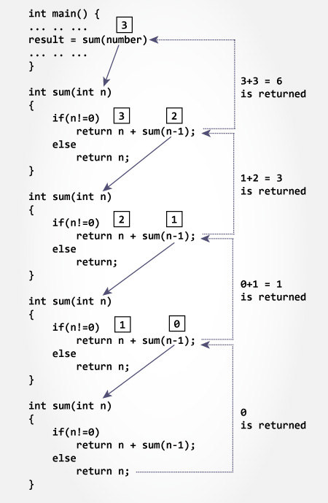

Slide 23
Program to find GCD using recursion
#include <stdio.h>
int hcf(int n1, int n2);
int main()
{ int n1, n2;
printf("Enter two positive integers: ");
scanf("%d %d", &n1, &n2);
printf("G.C.D of %d and %d is %d.", n1, n2, hcf(n1,n2));
return 0; }
int hcf(int n1, int n2)
{ if (n2 != 0)
return hcf(n2, n1%n2);
else return n1;
}
Enter two positive integers: 366 60
G.C.D of 366 and 60 is 6.

Slide 24
Thank You......

